Slide 1
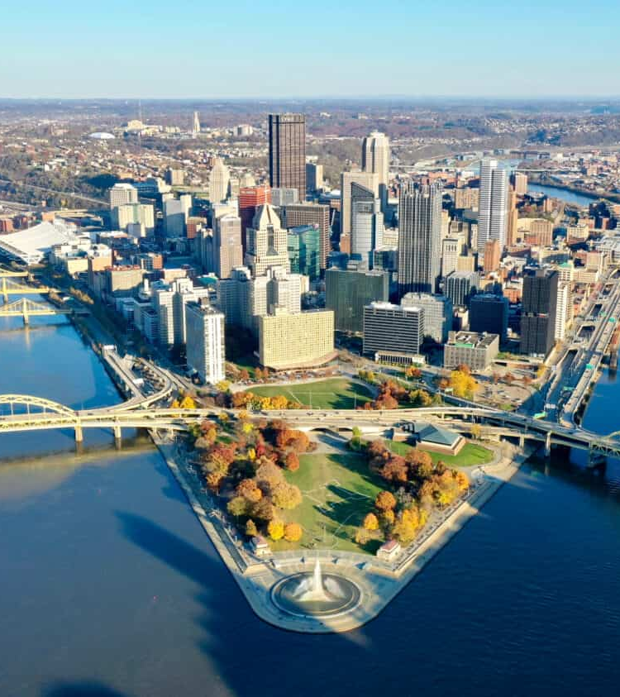
Is the City of Pittsburgh Truly a Bike Friendly City?
By: Tony Robol, Ruochong Zhu, & Jorge Cervantes

Slide 2

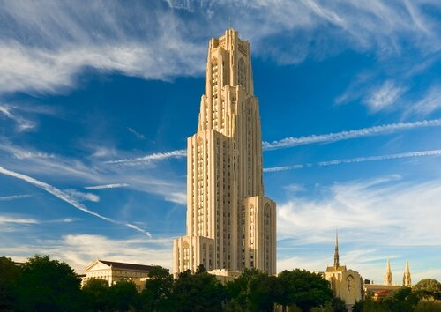

Table of Contents
Background – Bike(+) Master Plan
Objective – Is the City of Pittsburgh truly a Bike Friendly City?
POGOH – Data Cleaning
POGOH – Data Analysis
General Analysis
Convenience of Current Bike Routes Analysis
Distances Between Stations Analysis
University Body vs General Public Usage Analysis
Conclusion
Questions

Slide 3

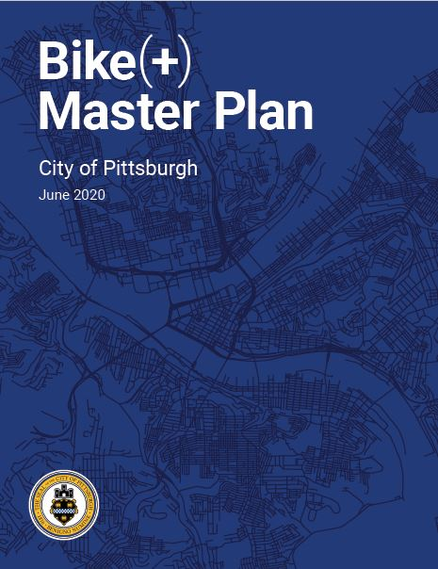
Background – Bike(+) Master Plan

Slide 4

Bike(+) Master Plan
June 2020 –
The Pittsburgh Bike(+) Plan establishes a vision to continue building a safe, comfortable, and convenient bike network for all types of riders and all types of trips.
Pittsburgh Mobility Goals:
No one dies traveling on city streets.
All households can access fresh fruits and vegetables within 20 minutes travel of home, without requiring a private automobile.
Walking and bicycling are the most joyful mode for short distance trips.
No household must spend more than 45% of household income for basic housing and mobility.
Pittsburgh streets and right of ways reflect the values of our community.

Slide 5
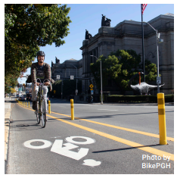
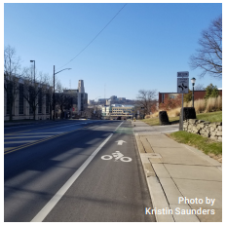
Bike(+) Master Plan
June 2020 –
Bike Infrastructure in Pittsburgh in 2020:
93 miles of bike infrastructure (about 40% of which are bike lanes).
31% of residents bike, walk, or ride public transit to get to work.
23% of Pittsburgh households do not have access to a personal automobile.
2.1% of City of Pittsburgh commuters bike to work.
Over 500 bikes at 113 Healthy Ride stations, and 66,000 active users.

Slide 6
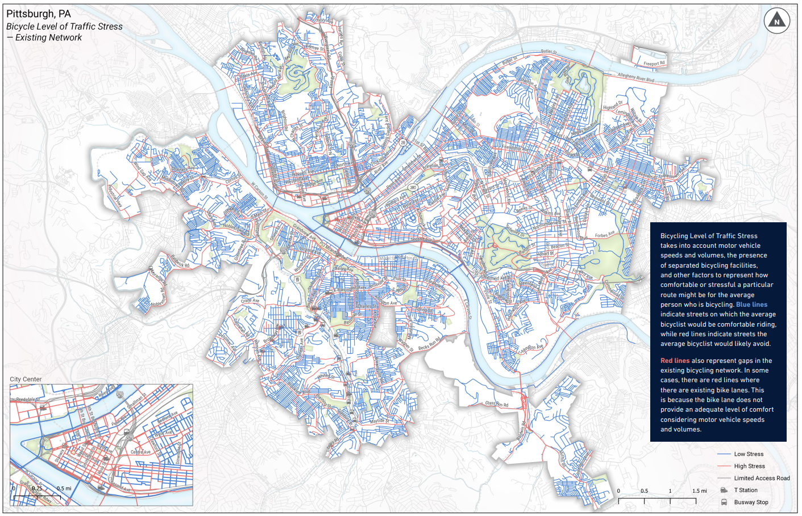

Slide 7

Bike(+) Master Plan
MoveForwardPGH (2020 – 2022) –
Collaboration between Department of Mobility and Infrastructure (DOMI), BikePGH and POGOH (formerly Healthy Ride).
BikePGH – a non-profit organization working on behalf of the Pittsburgh community to make the city safe, accessible, and friendly to bicycle transportation.
After launching in 2015 with 50 stations, POGOH had over 500 bikes at 113 stations and over 66,000 active users in 2020.
Engaged the community throughout the process of installing new bike-friendly connections throughout Pittsburgh.

Slide 8
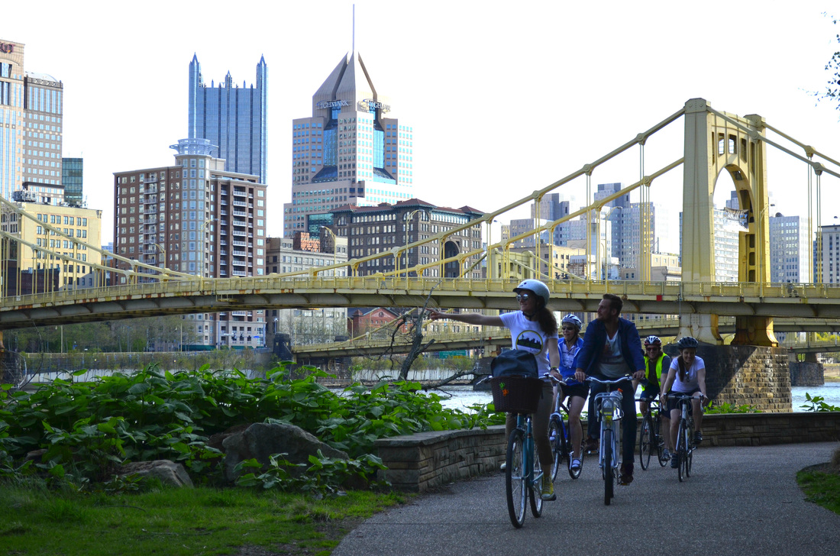
Is the City of Pittsburgh truly a Bike Friendly City?

Slide 9

Is the City of Pittsburgh truly a Bike Friendly City?
Over the last couple of years, bike lanes have been built all throughout the city of Pittsburgh.
POGOH has installed over 113 bike rental stations throughout the city.
Allows non-bike-owners to be able to use said bike lanes.
These two developments are part of the goal of increasing the Bike Friendliness of the city.
Introducing an alternative transportation method for commuters.
However:
Does the use of bikes by the student /staff population of the University of Pittsburgh significantly impact the Bike Friendliness Rating of the city, compared to other users?
In other words, does most of the bike usage come from the university, or from the general public?

Slide 10

POGOH – Data Cleaning Process

Slide 11

POGOH – Data Cleaning Process
Download POGOH and Bike Lanes Data from the Western Pennsylvania Regional Data Center
Download past 12 months of POGOH Trip Data.
Download POGOH Station Locations from February 2023 to October 2023.
Download On-road Bicycle Pavement Markings.
Convert and Import Excel Files into CSV files to be read into Jupyter Notebook / R Studio.
Reformat April 2023 dataframe to match the dataframe formatting of the other Trip Data.
Compile all 12 Trip Data dataframes into one single dataframe to facilitate analysis.

Slide 12

POGOH – General Data Analysis

Slide 13
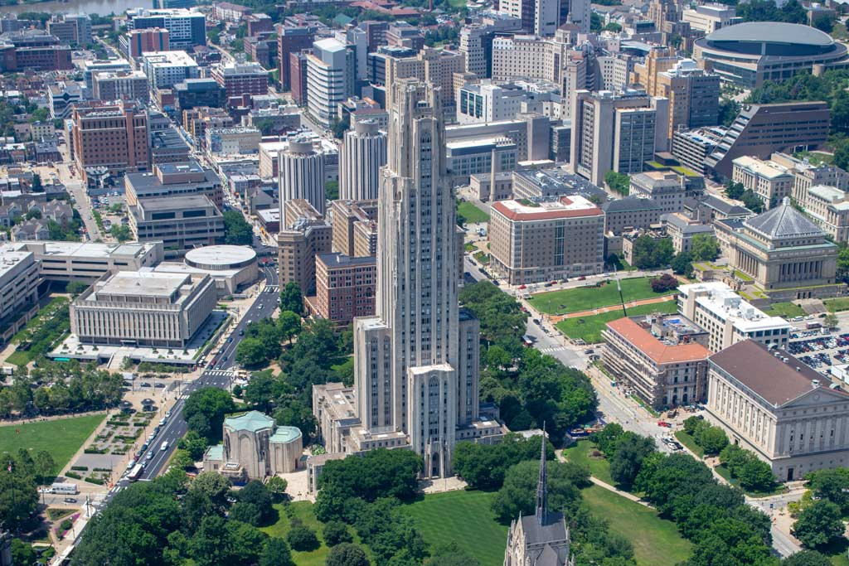
POGOH – General Data Analysis
Important Values found and taken into consideration in the rest of the analysis.
Average Duration of Bike Ride: 21.44627 minutes.
Top 6 Routes Traveled:
Boulevard of the Allies & Parkview Ave to S Bouquet Ave & Sennott St
Average Route Duration: 16.889613 min
Number of Trips: 4,108
S Bouquet Ave & Sennott St to Boulevard of the Allies & Parkview Ave (Reverse of Route Above)
Average Route Duration: 12.404846 min
Number of Trips: 3,787
N Dithridge St & Centre Ave to O'Hara St and University Place
Average Route Duration: 10.484202 min
Number of Trips: 2,737

Slide 14
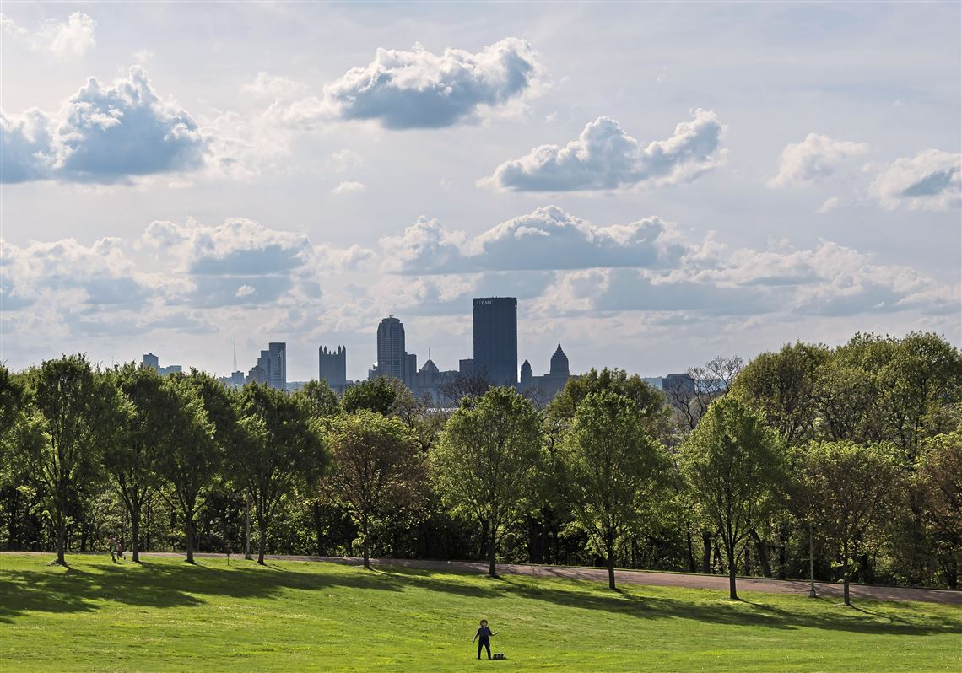
POGOH – General Data Analysis
Important Values found and taken into consideration in the rest of the analysis.
Top 6 Routes Traveled: (Continued)
O'Hara St and University Place to N Dithridge St & Centre Ave (Reverse of Route In Previous Slide)
Average Route Duration: 6.689241 min
Number of Trips: 2,353
S Bouquet Ave & Sennott St to Zulema St & Coltart Ave
Average Route Duration: 14.000111 min
Number of Trips: 2,166
Forbes Ave & Schenley Dr to Boulevard of the Allies & Parkview Ave
Average Route Duration: 12.672830 min
Number of Trips: 2,053

Slide 15
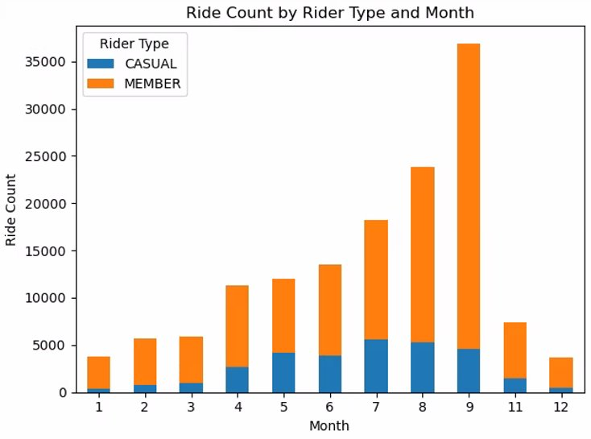
POGOH – General Data Analysis
Important Values found and taken into consideration in the rest of the analysis.
Type of Rider by Percentage:
Member - 83.10368% (Annual / Prepaid / Corporate Pass)
Casual - 16.89632% (“Pay-as-You-Go”)
Number of Relocked / Cancelled Trips
GRACE_PERIOD – 11,281 Trip Attempts (Bike Relocked Before Start of Trip)
Average Time Wasted – 0.3899388 min
Total Time Wasted – 4,398.9 min
FORCED_CLOSED – 238 Trips Cancelled (Trip Ended by Staff, Incorrect Data)
TERMINATED – 234 Trips Cancelled (Trip Ended by Staff, Incorrect Data)

Slide 16
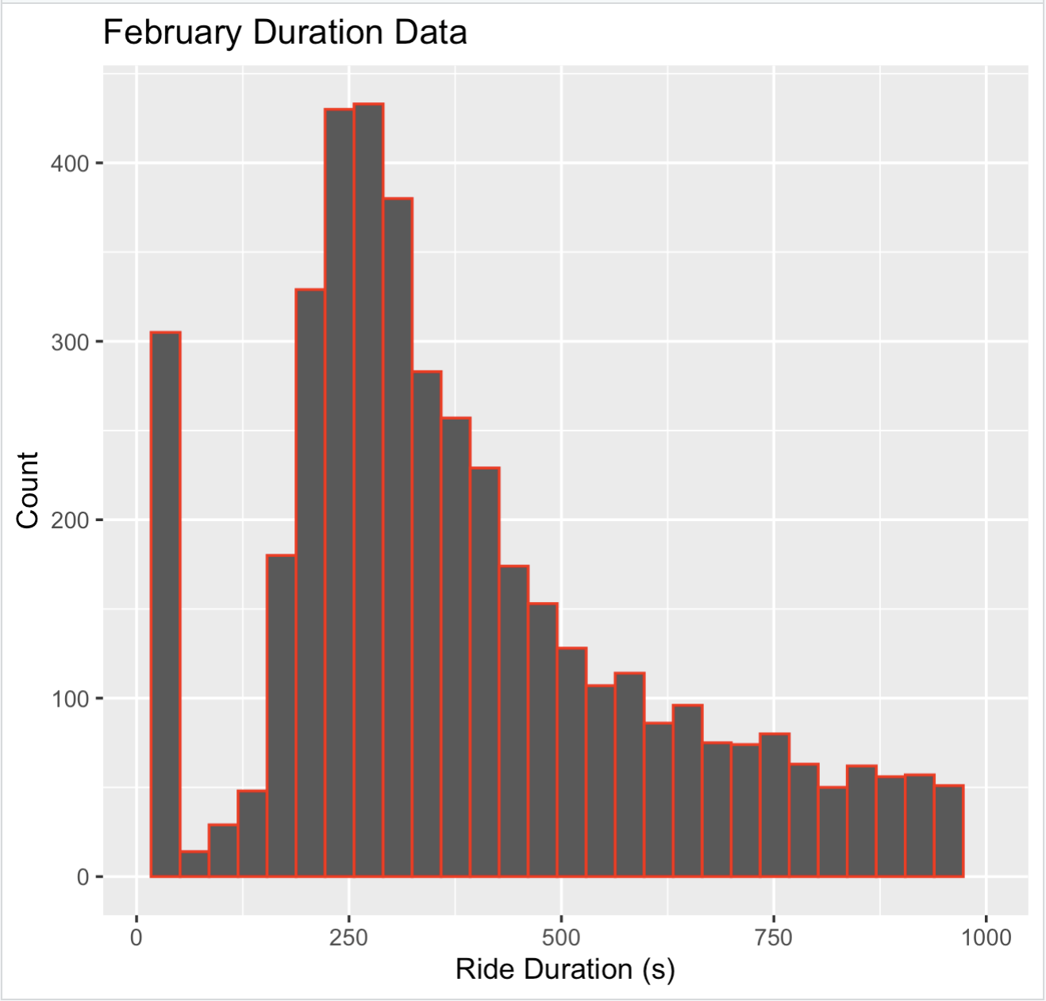
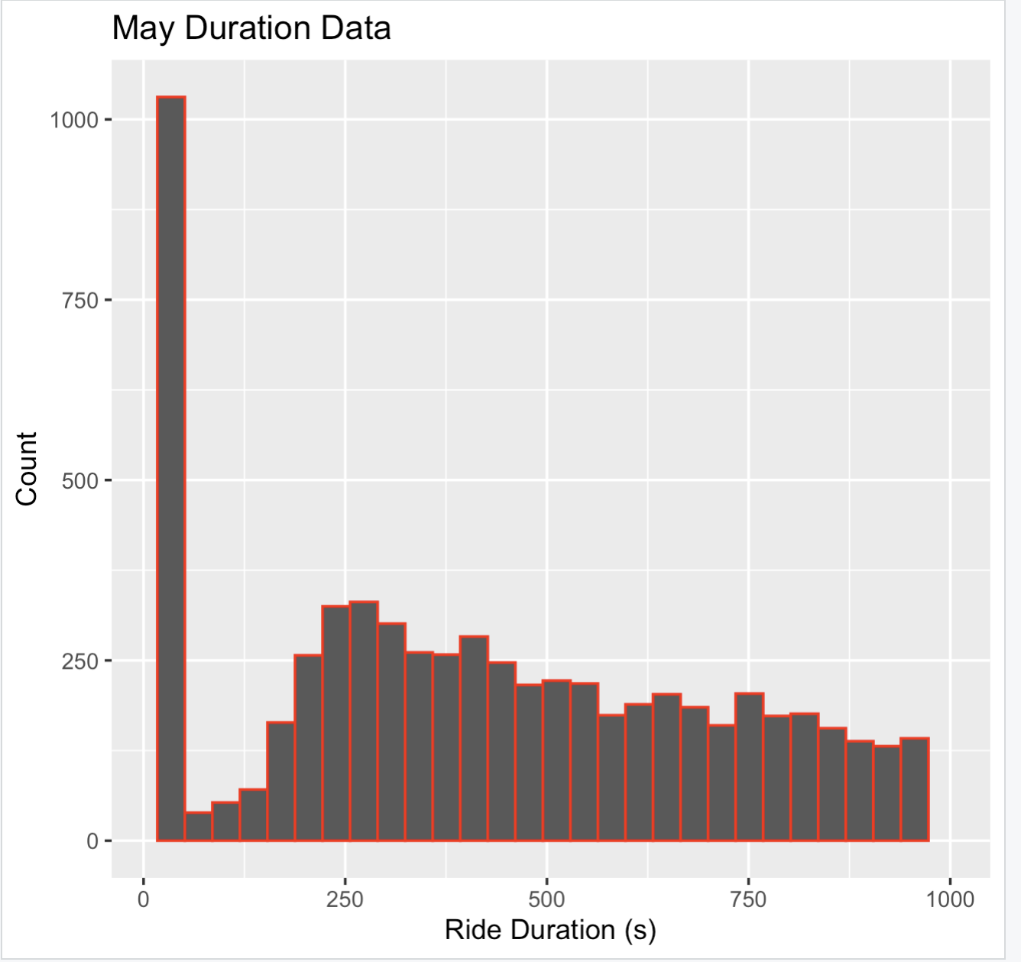
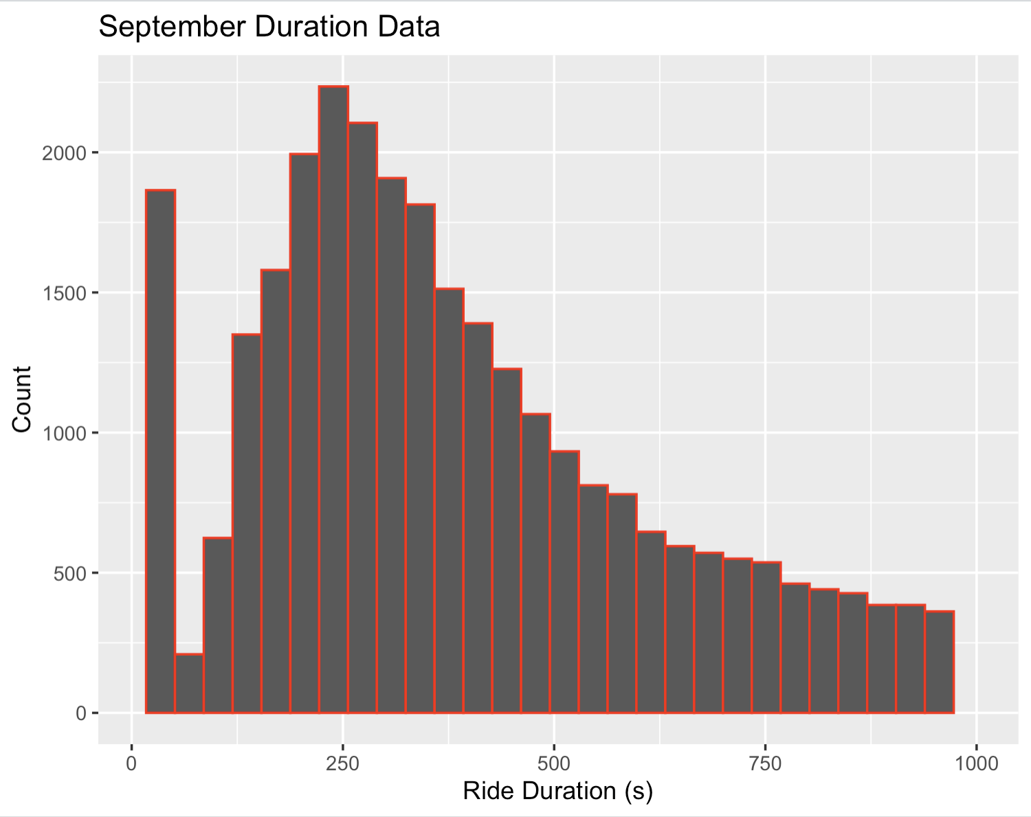
POGOH – Ride Duration Analysis

Slide 17
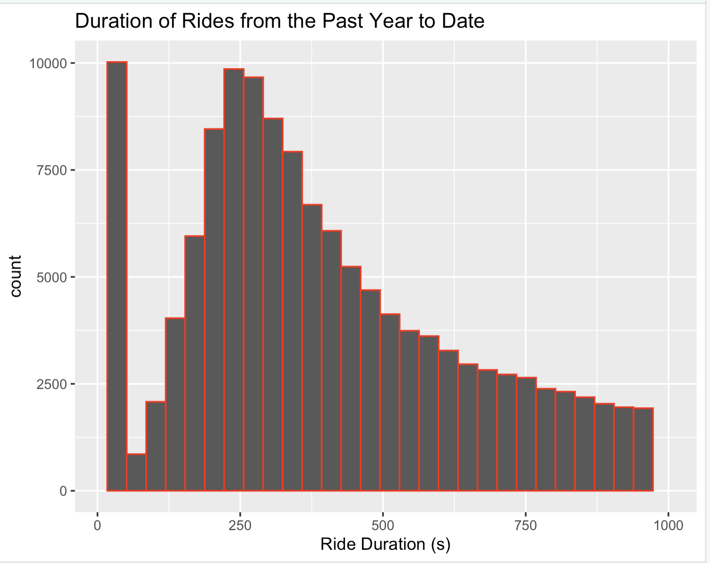
POGOH - Ride Duration Analysis

Slide 18
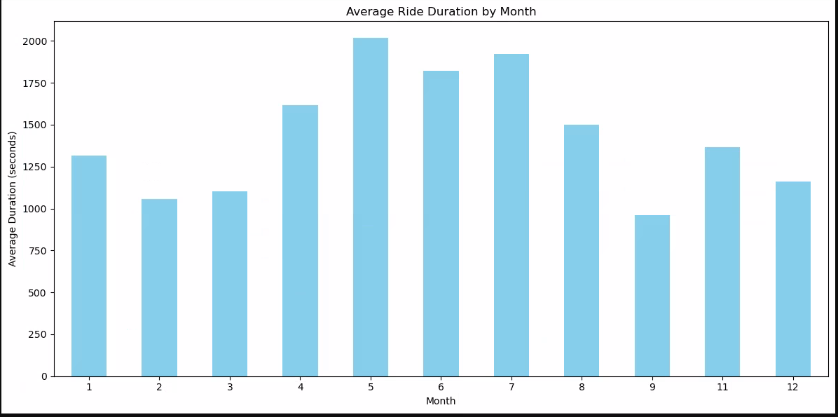
POGOH - Ride Duration Analysis

Slide 19
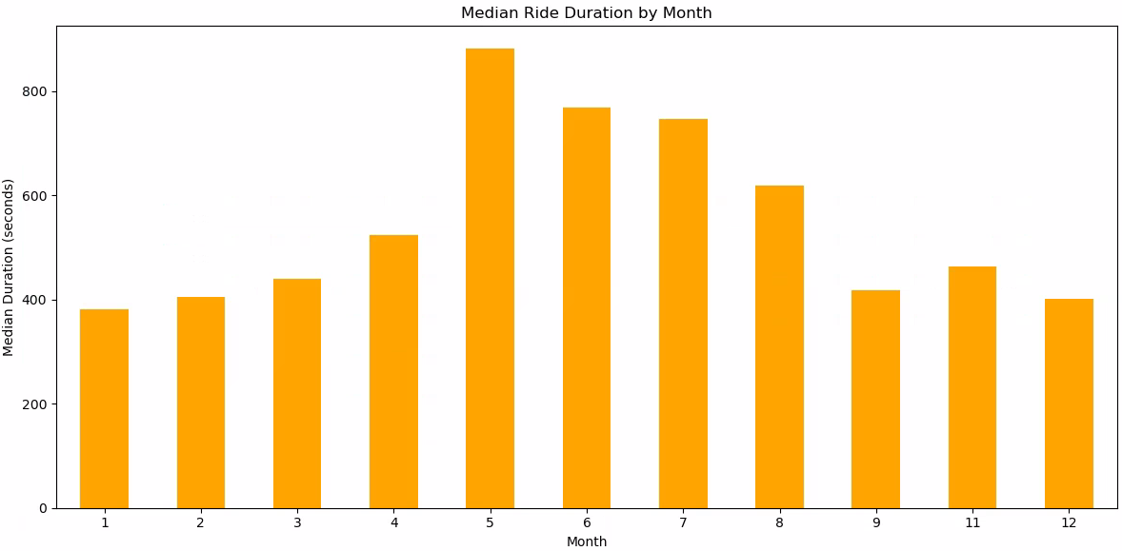
POGOH - Ride Duration Analysis

Slide 20
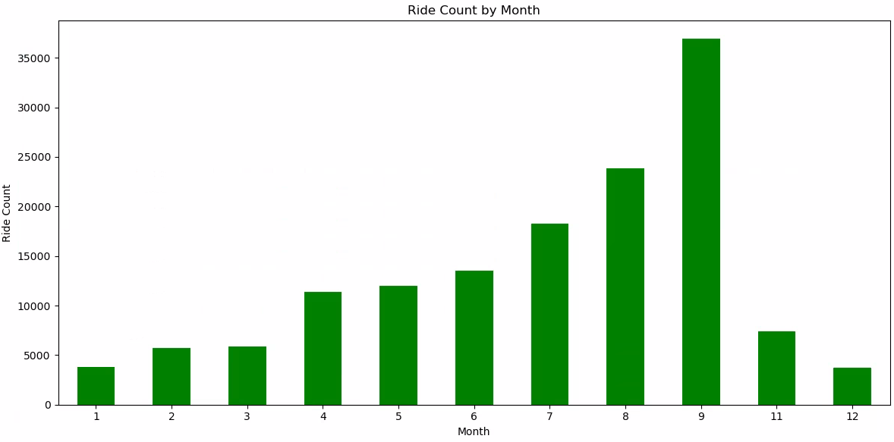
POGOH - Ride Duration Analysis

Slide 21
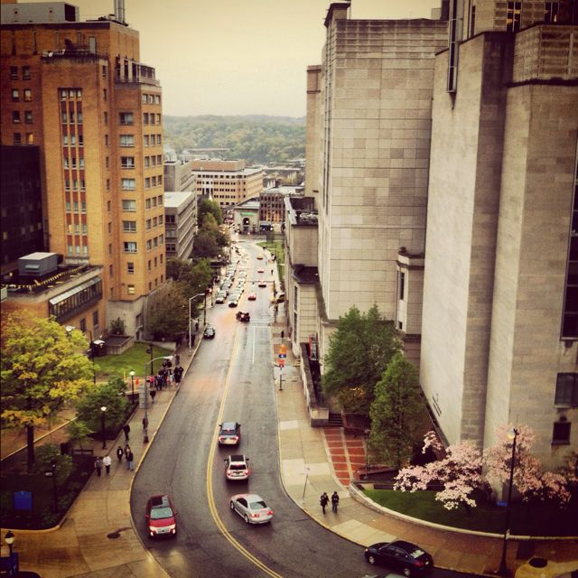
POGOH – Convenience of Current Bike Routes Analysis

Slide 22
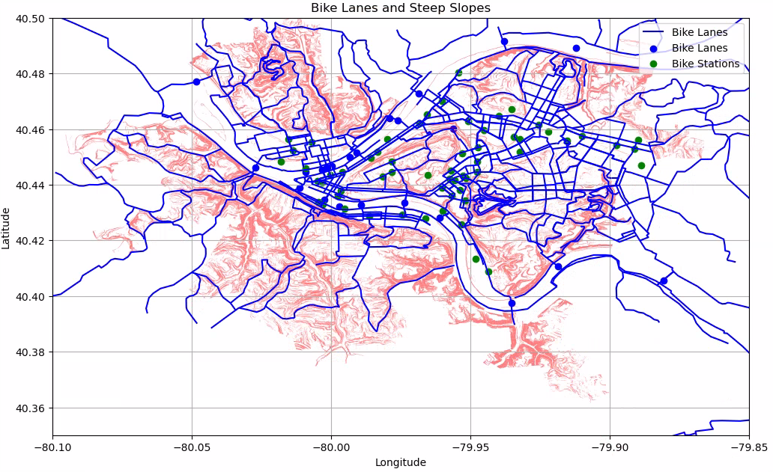
POGOH - Convenience of Current Bike Routes Analysis

Slide 23
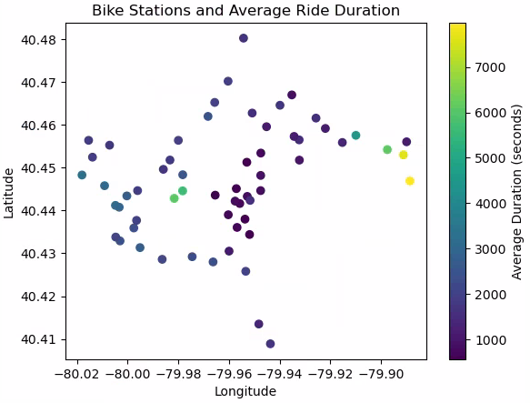
POGOH - Convenience of Current Bike Routes Analysis

Slide 24

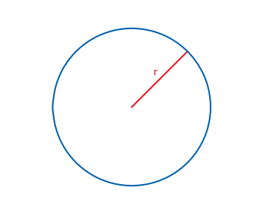
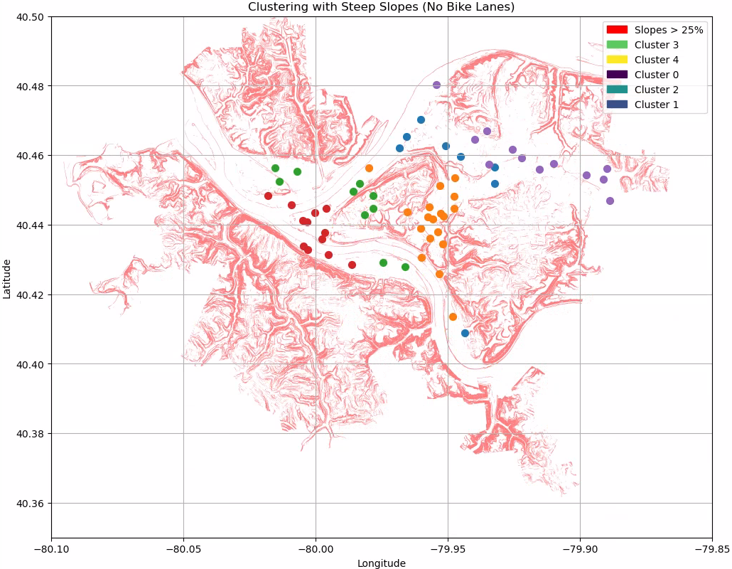
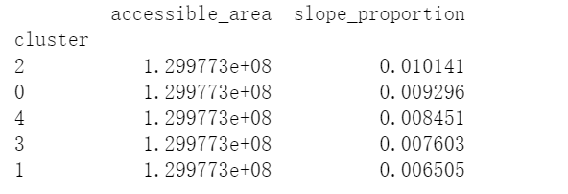


POGOH - Convenience of Current Bike Routes Analysis
4 miles
Based on slope proportion and reachable lane length

Slide 25
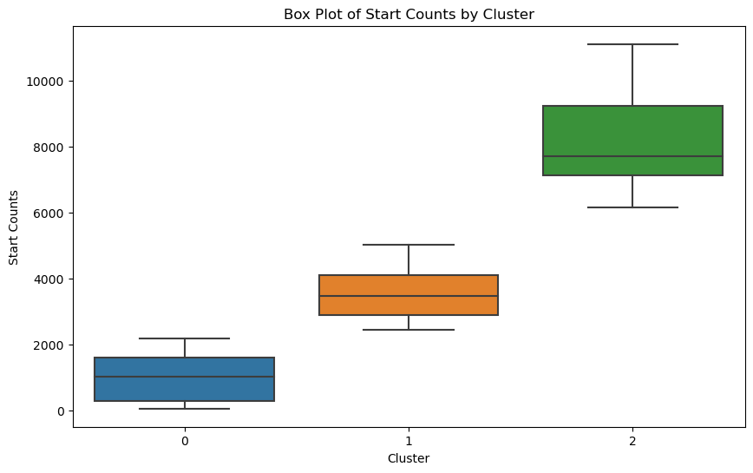
POGOH - Convenience of Current Bike Routes Analysis
Based on slope proportion and reachable lane length​, and starting amount

Slide 26
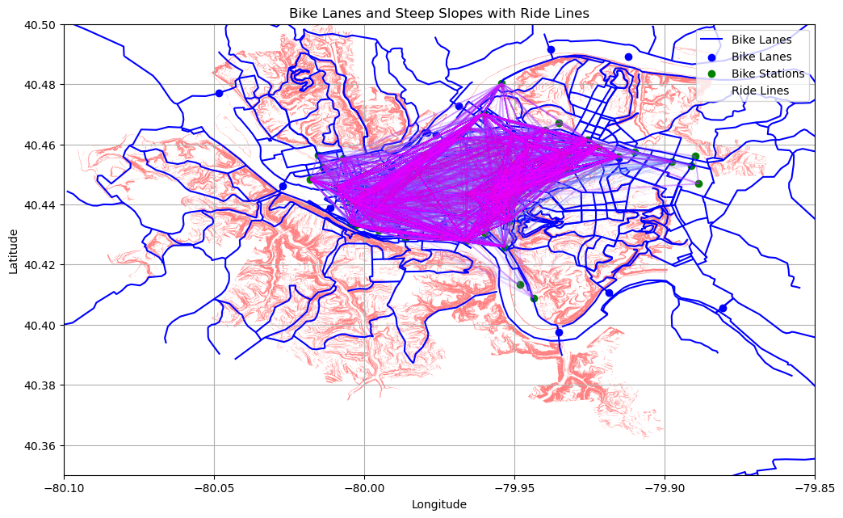


POGOH - Convenience of Current Bike Routes Analysis For bike construction reference
Next step: decide where to put the lane based on GIS

Slide 27
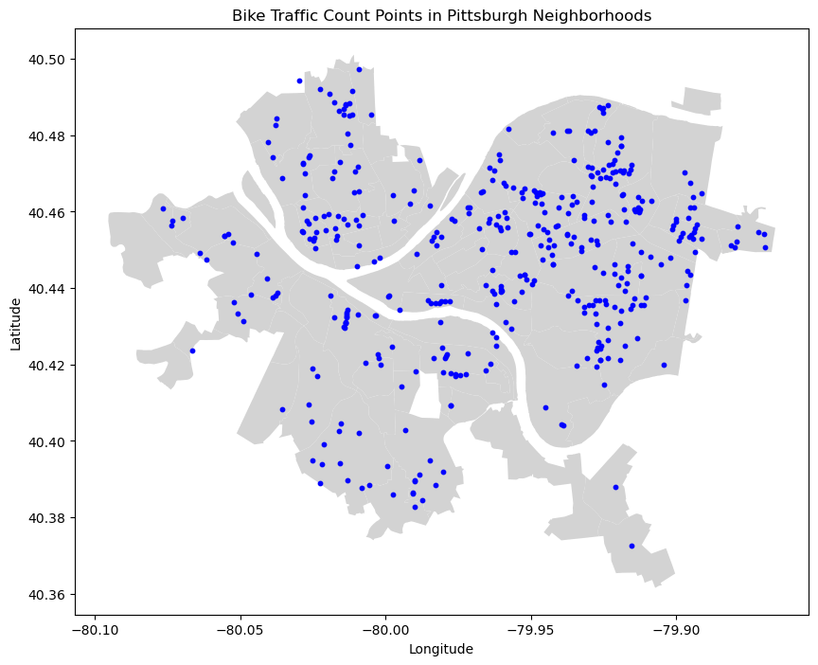



Analyzing Neighborhood Variability in Bicycle-Friendliness
Gathering Data:

Slide 28
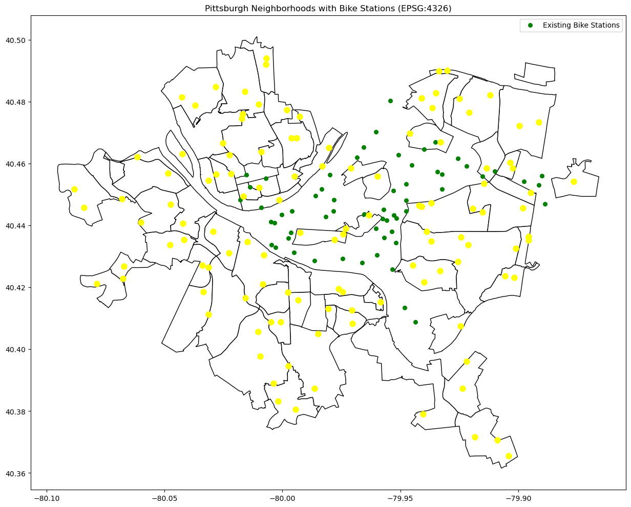
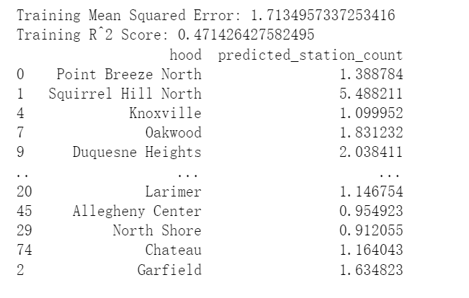
POGOH - Convenience of Current Bike Routes Analysis
Ridge Regression to predict the future station with all features over 0.2

Slide 29
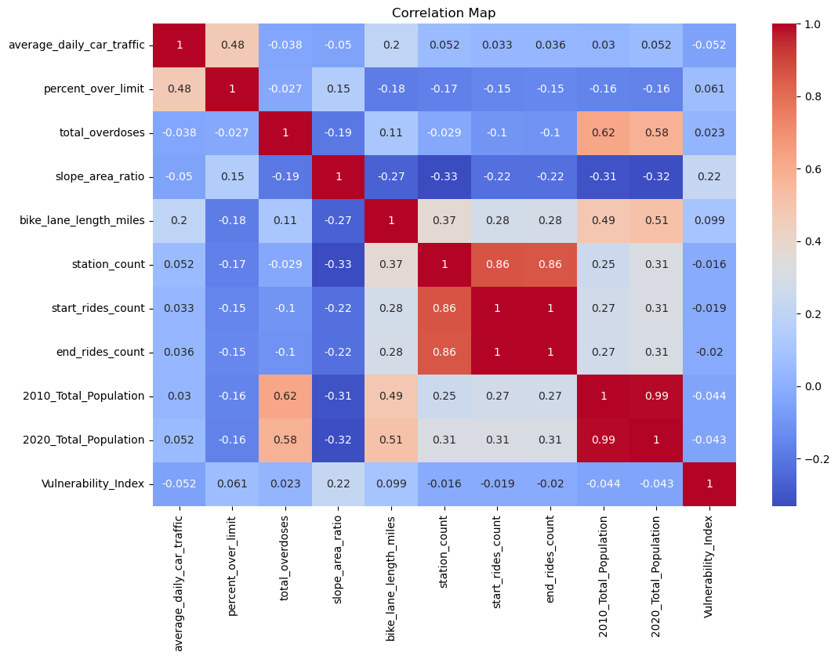
Analyzing Neighborhood Variability in Bicycle-Friendliness

Slide 30
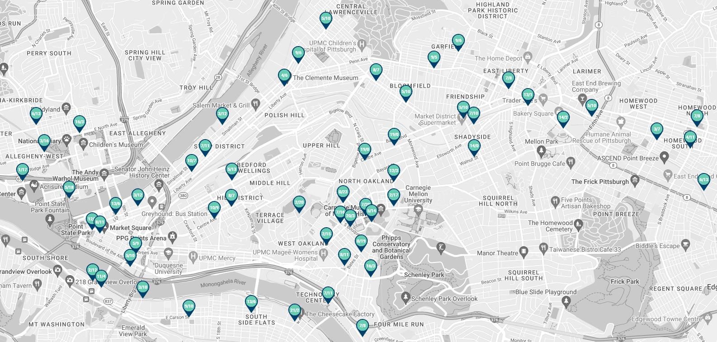
POGOH – Distances Between Stations Analysis

Slide 31
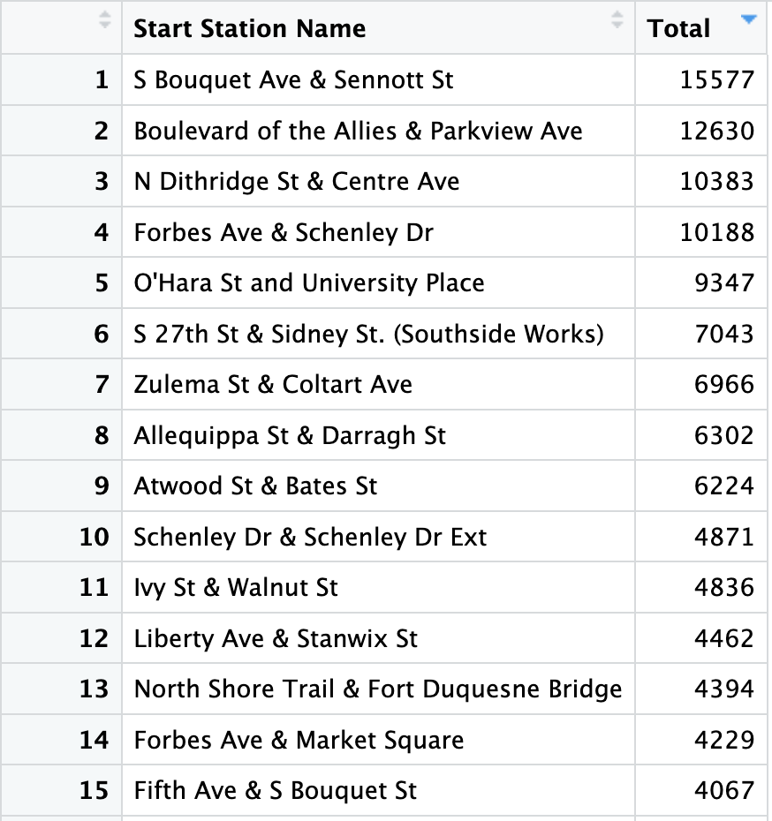
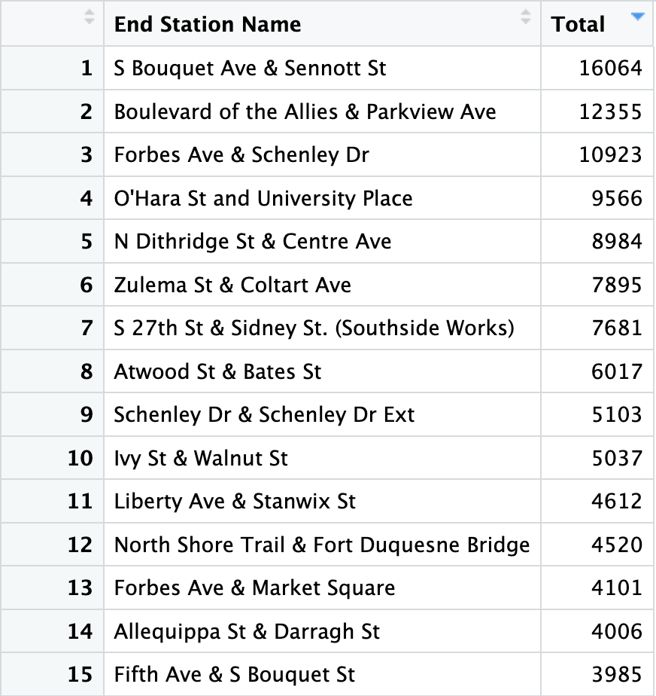
POGOH - Distances Between Stations Analysis
Group Data by station to see the most popular stations in terms of starting and ending points

Slide 32
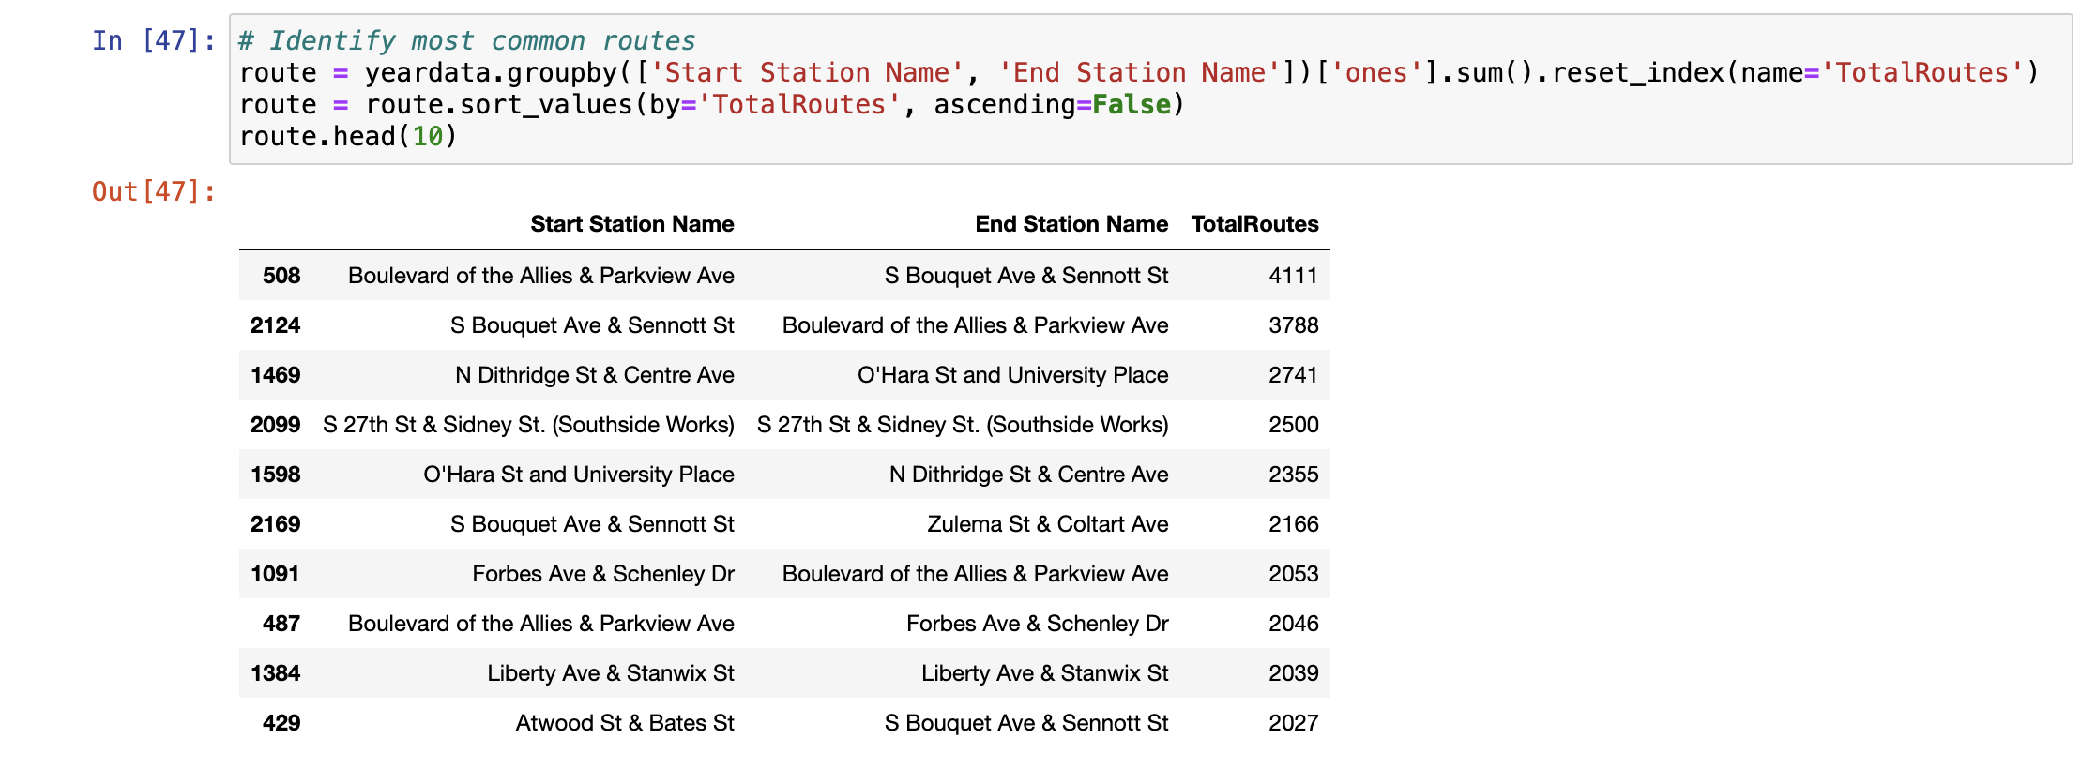
POGOH - Distances Between Stations Analysis
Identify the most common route combinations

Slide 33

Is there an association between average distance to all other stations and usage?

Slide 35
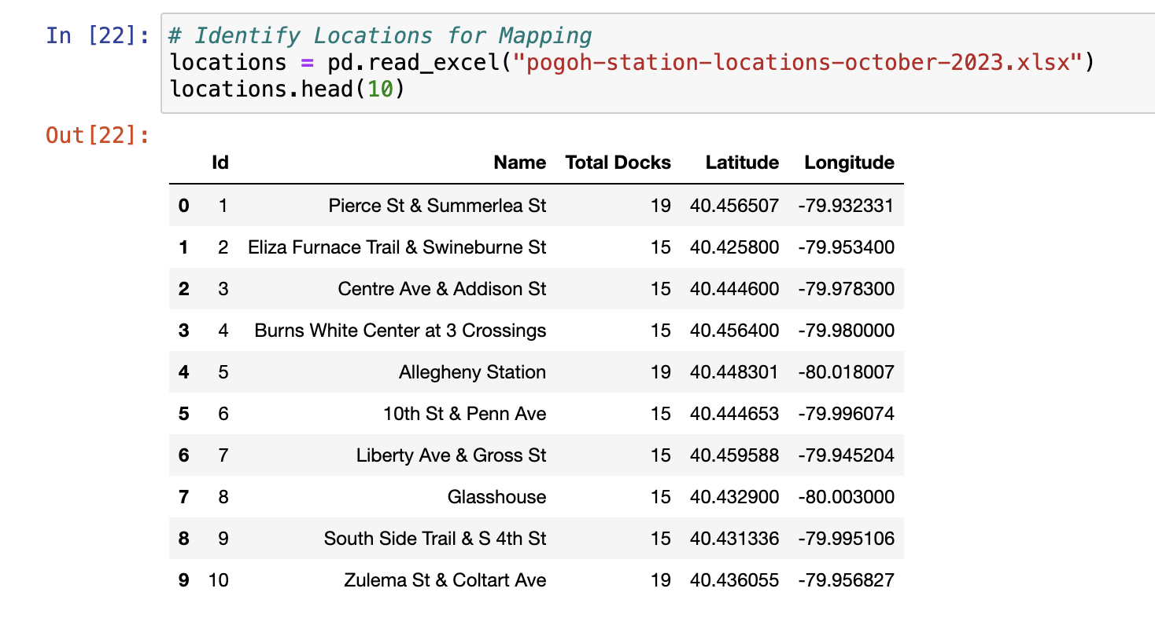
POGOH - Distances Between Stations Analysis
Read in data containing longitude and latitude information

Slide 36
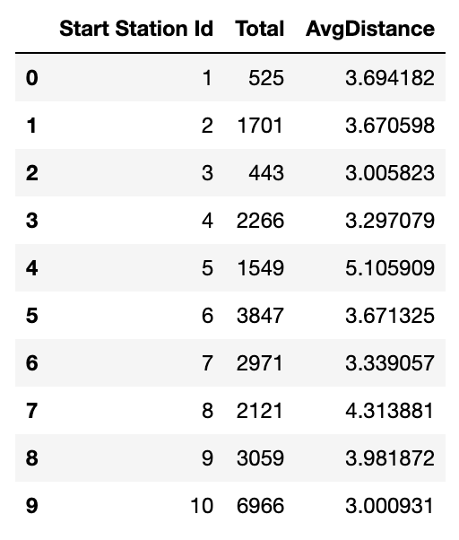
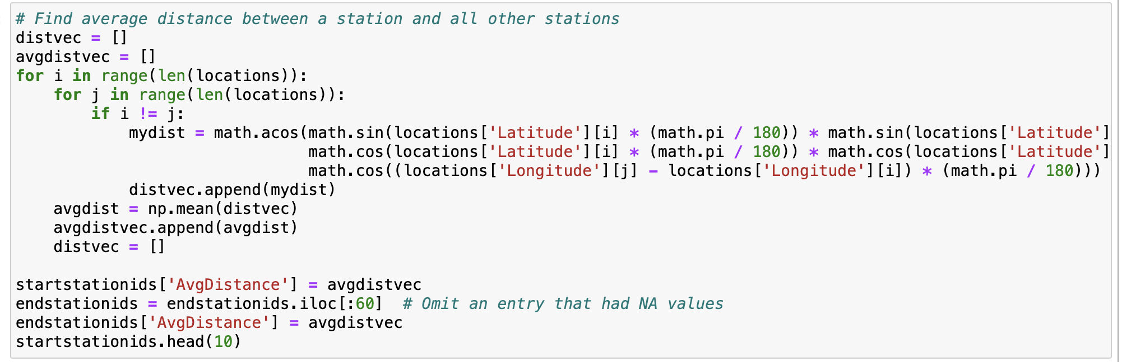
POGOH - Distances Between Stations Analysis
Python code to compute the average distance between a given station and the 59 other stations

Slide 37
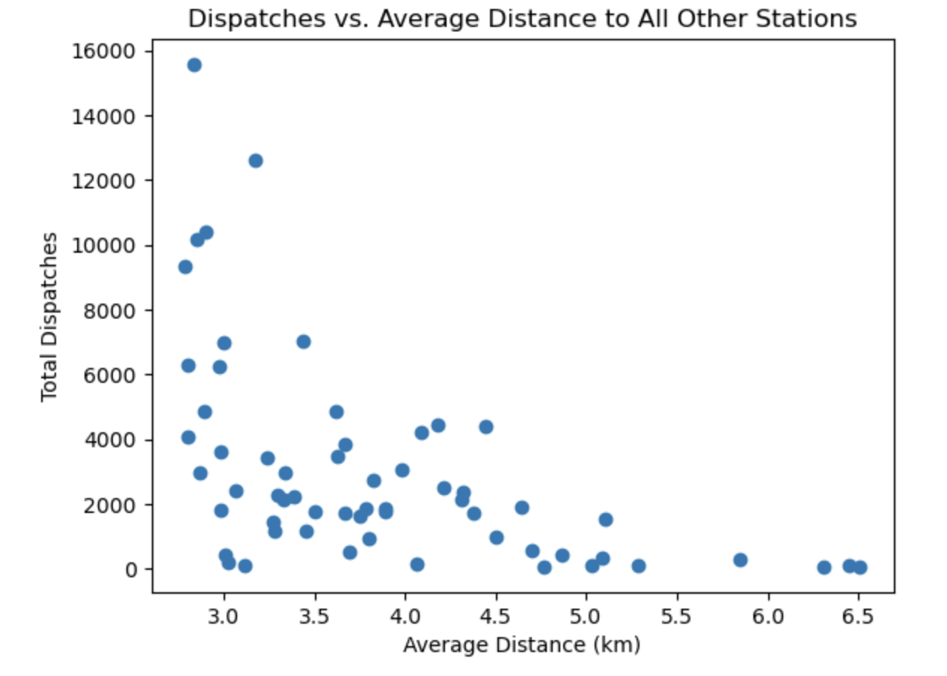
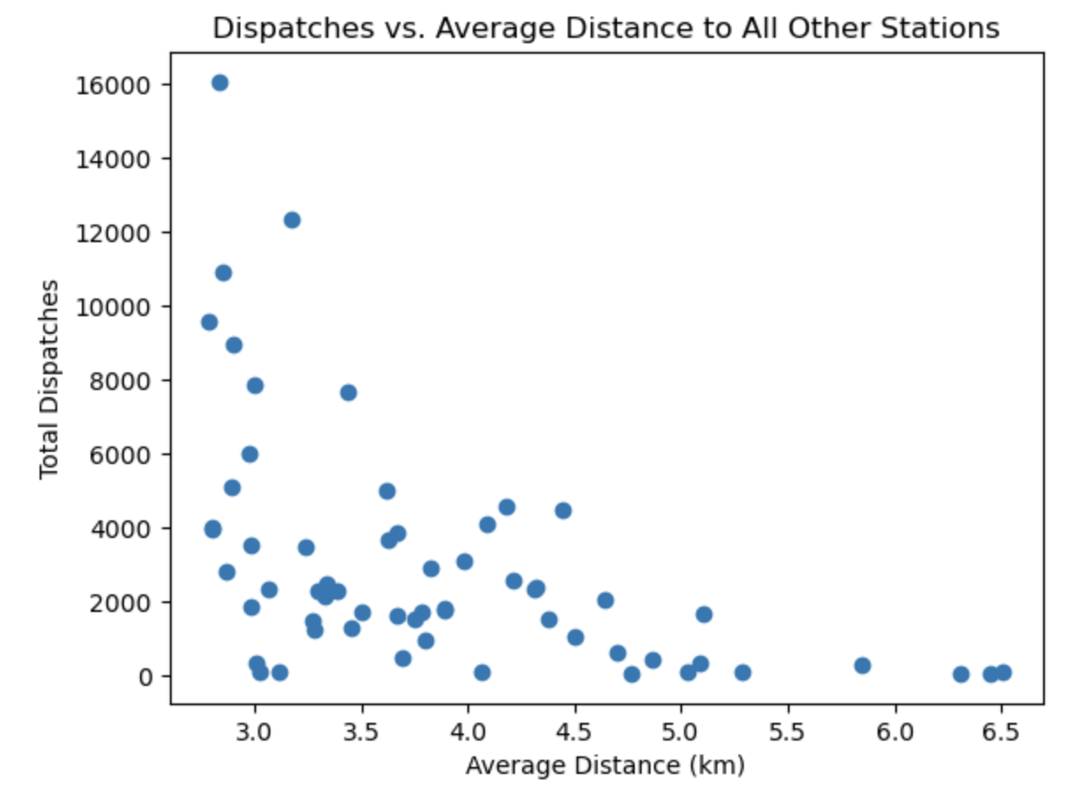
POGOH - Distances Between Stations Analysis
Start Station
End Station

Slide 38
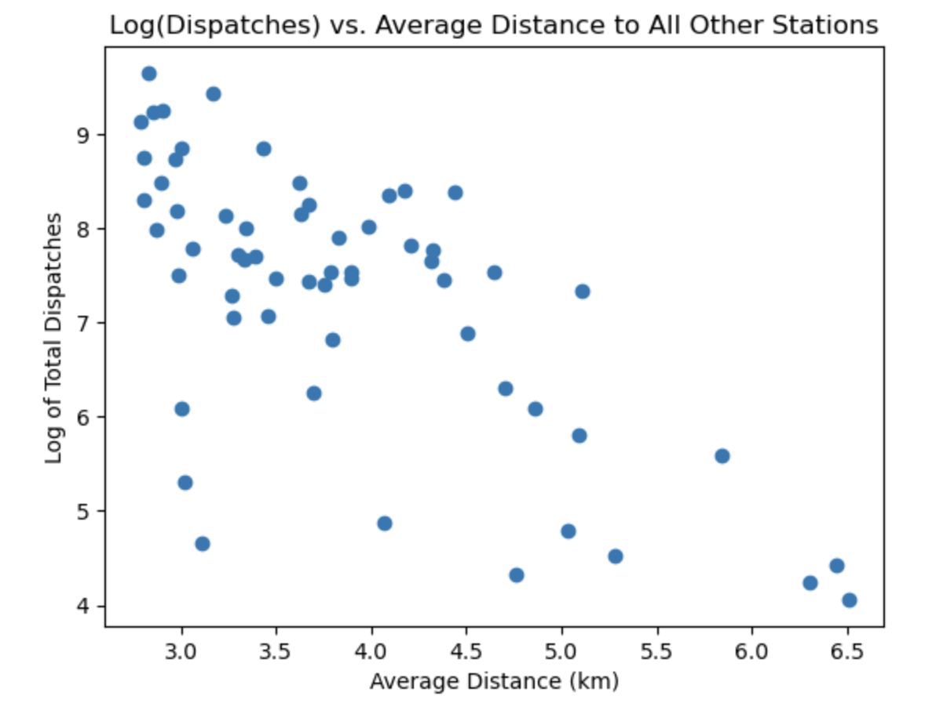
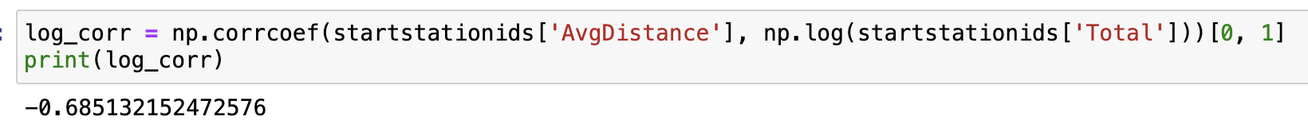
POGOH - Distances Between Stations Analysis
Is there an exponential (decay) relationship between total dispatches and average distance?

Slide 39
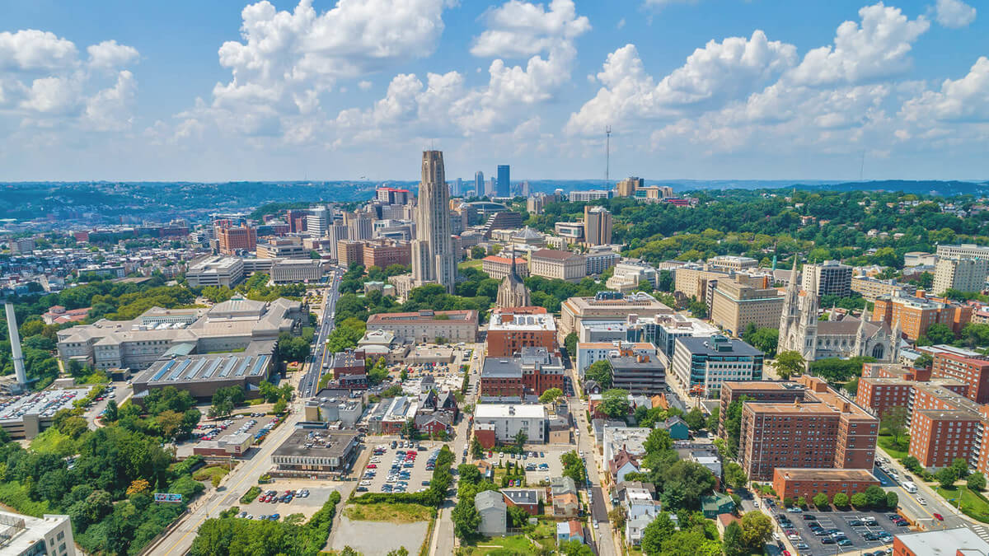
POGOH – University Body (Pitt) vs General Public Usage Analysis

Slide 40
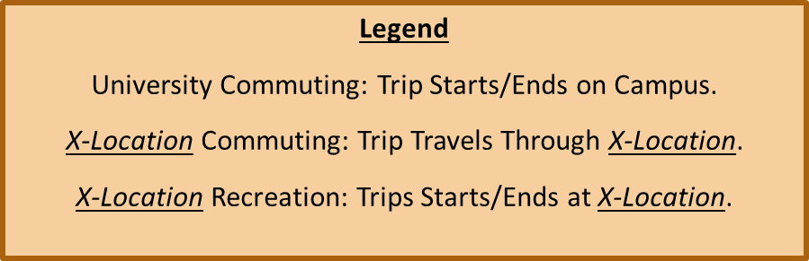
POGOH - University Body (Pitt) vs General Public Usage Analysis
Top 18 Routes in Total Number of Trips:
Number 1: 4,108 Trips (University Commuting)
Number 2: 3,787 Trips (University Commuting)
Number 3: 2,737 Trips (University Commuting)
Number 4: 2,353 Trips (University Commuting)
Number 5: 2,166 Trips (University Commuting)
Number 6: 2,053 Trips (Schenley Park Recreation)

Slide 41
POGOH - University Body (Pitt) vs General Public Usage Analysis
Top Number of Trips:
Number 7: 2,044 Trips (Schenley Park Recreation)
Number 8: 2,027 Trips (University Commuting)
Number 9: 2,006 Trips (South Side Recreation)
Number 10: 1,999 Trips (University Commuting)
Number 11: 1,836 Trips (University Commuting)
Number 12: 1,504 Trips (University Commuting)

Slide 42
POGOH - University Body (Pitt) vs General Public Usage Analysis
Top Number of Trips:
Number 13: 1,477 Trips (North Oakland Commuting)
Number 14: 1,454 Trips (University Commuting)
Number 15: 1,423 Trips (Downtown Recreation)
Number 16: 1,227 Trips (University Commuting)
Number 17: 1,155 Trips (North Oakland Commuting)
Number 18: 1,124 Trips (University Commuting)

Slide 43
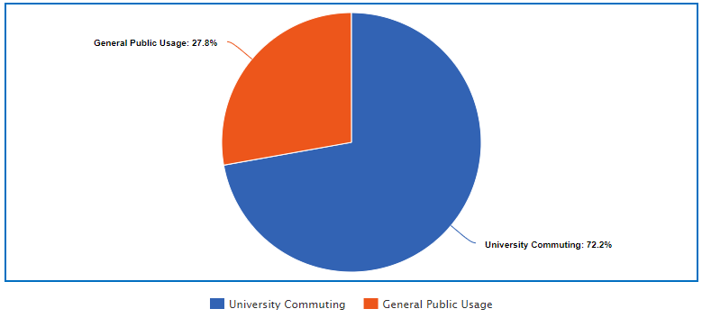
POGOH - University Body (Pitt) vs General Public Usage Analysis
In the Top 18 Most Popular Routes:
Over the 12 Months documented, a total of 36,530 Trips were completed.
26,372 of those Trips were University Commuting.
That is 72.19% of the total Trips.
12 of the Top 18 were University Commuting.
That is 66.67% of the Top 18 Most Popular Routes.
15 of the Top 18 were on average less than 20 minutes.
University Students get Unlimited 30-minute bike rides, daily.
Overall, over the 12 Months documented, a total of 168,658 Trips were completed.
At least 15.64% of the total Trips were University Commuting.

Slide 44
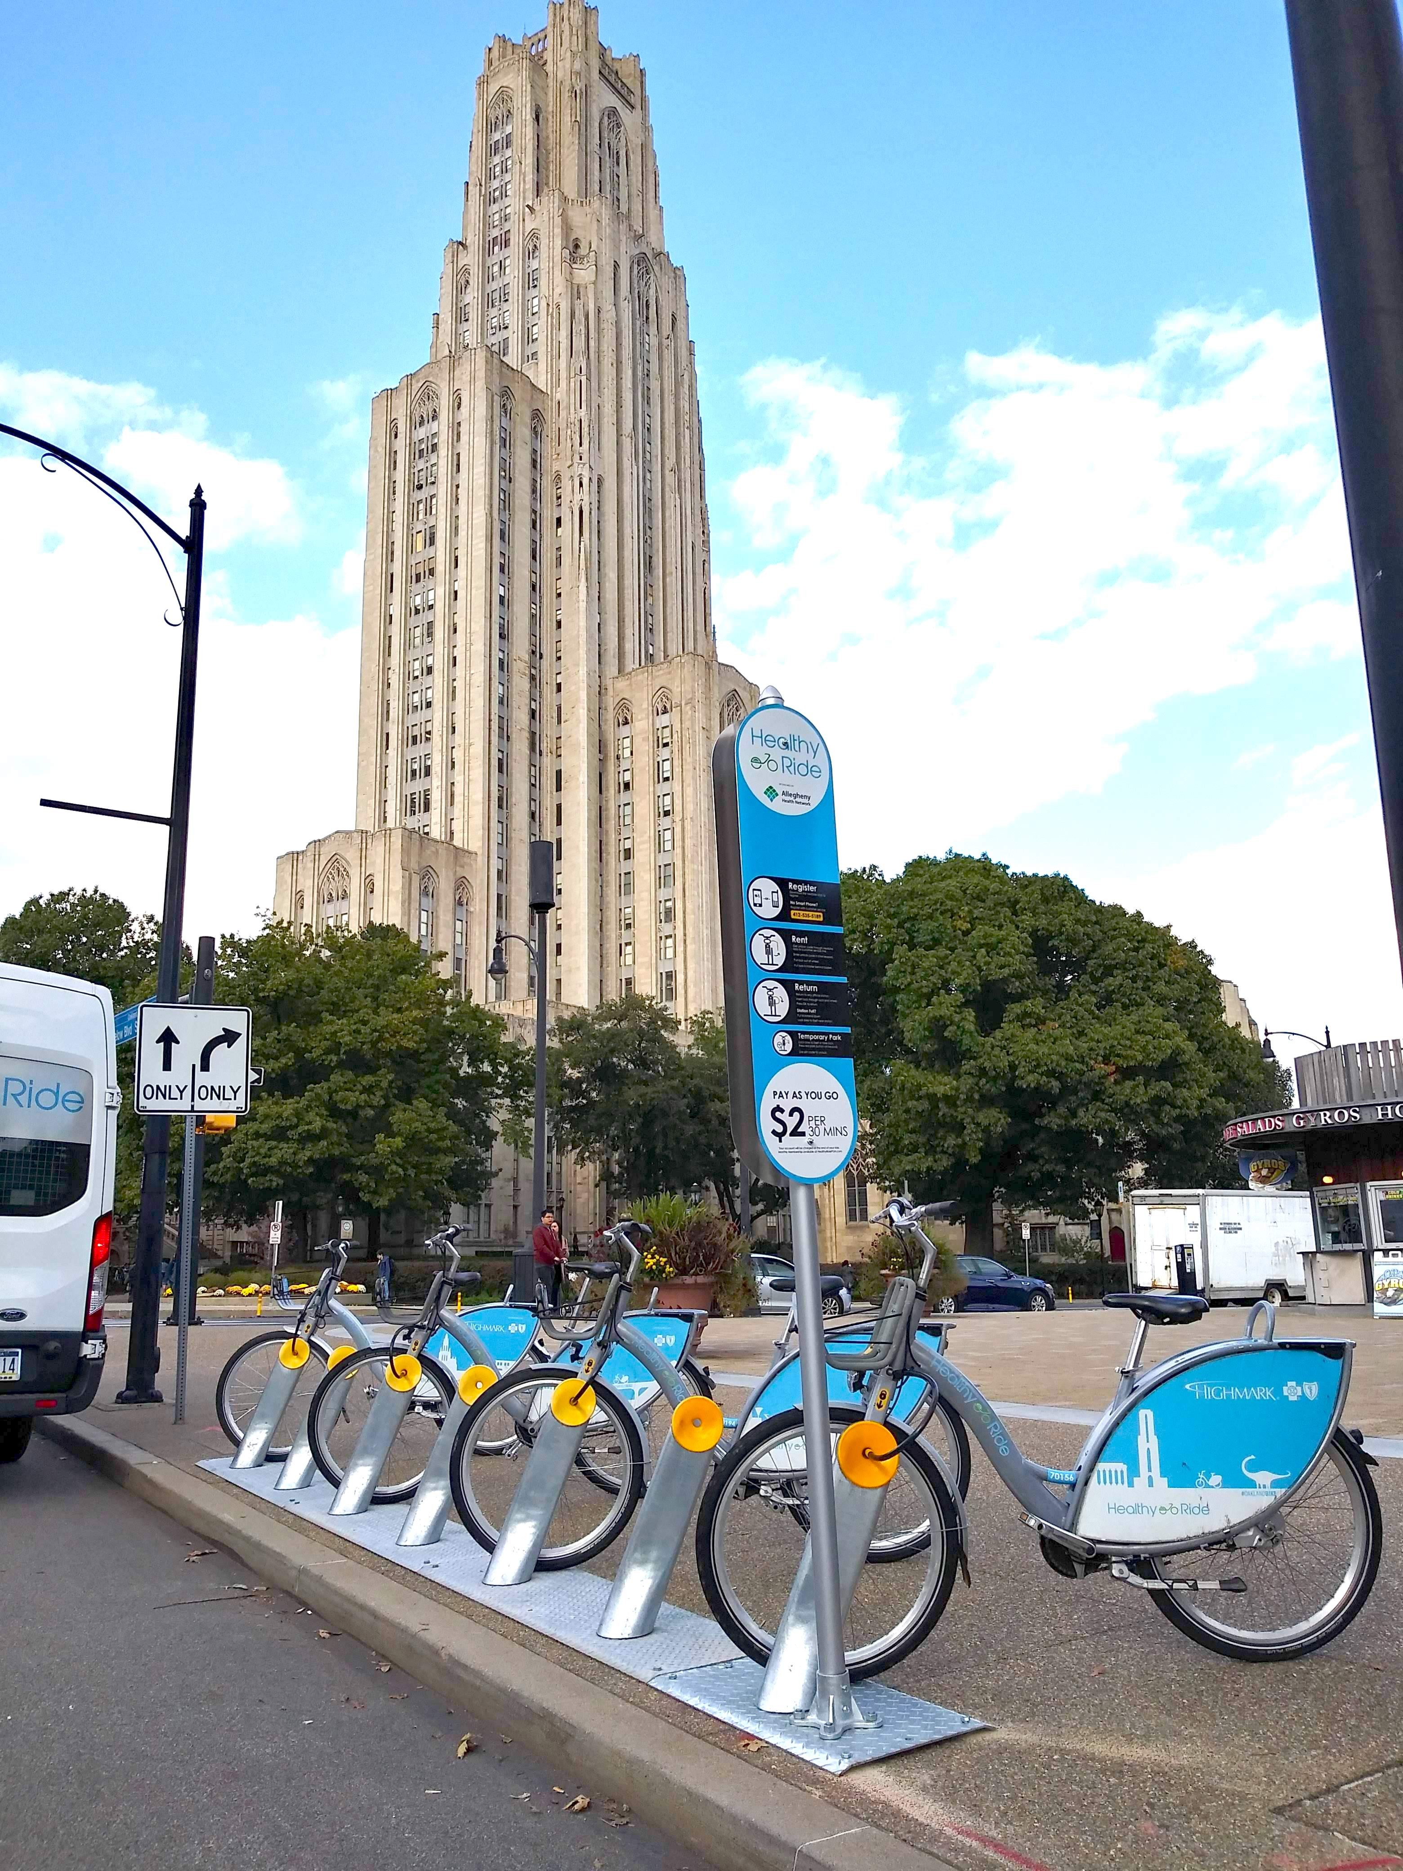
POGOH - University Body (Pitt) vs General Public Usage Analysis
Overall:
Pittsburgh University Commuting does not make up most of the total Pittsburgh bike usage.
However, it is a significantly large percentage with just the Top 18 Most Popular Routes.
With 2,724 different observed routes, it was difficult to determine every type of route.
Could not get a final percentage of how truly large University Commuting is in the data.
Considering Route Popularity Number 19 and Number 20 are also University Commuting:
Likely that final percentage is much larger than 15.64% of the total Trips.
General Public Commuting / Recreation is definitely an influential part.
Split between too many different routes.
Not very consistent/popular routes, unlike University Commuting.
Regardless, General Commuting / Recreation had 6 routes within the Top 18.
Money / Cost not a significant factor since 83.1% of riders have pre-paid plans.

Slide 45
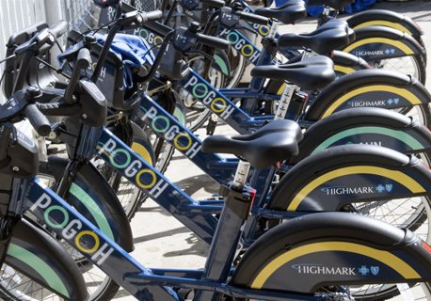
Conclusion
Convenience:
Station Convenient
Neighborhood Difference and Prediction on Station location
Distance:
Start and end station data can be used relatively interchangeably
Exponential decay relationship between total dispatches and average distance to all other stations
Main Type of Use:
The City of Pittsburgh is very accessible to both University Commuters and General Public Commuters / Recreationists.
Large amount of bike-route use all throughout the city.
Therefore:
The City of Pittsburgh is truly the Bike Friendly City that was planned since 2020.
The Bike(+) Master Plan has been successful.

Slide 46

Questions?

